Slide 1
Introduction to Computer Systems

Slide 2
Outline
Teaching staffs
Textbook and Grading
Motivation

Slide 3
Instructor & TAs
Dr. Tao Li
Email: 13923888011@163.com
Course Website: ics.fudan.edu.cn

Slide 4
Text Books & Web Site
Randy Bryant and David O’Hallaron,
  Computer Systems: A Programmer’s Perspective
  2nd Edition
  Prentice Hall, 2011.
Brian Kernighan and Dennis Ritchie,
  The C Programming Language, Second Edition
  Prentice Hall, 1988

Slide 5
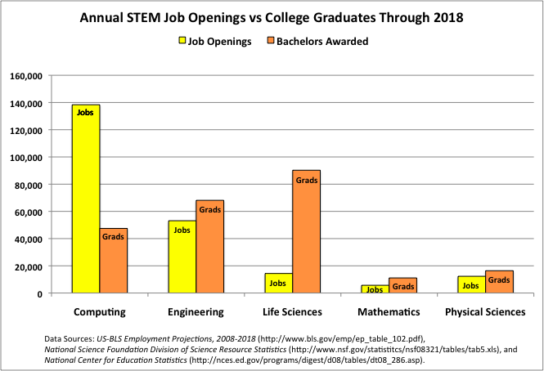
Understanding Supply Versus Demand

Slide 6
Increasing the Footprint of CS
Data mining
Databases
Hardware
Robotics
Machine Learning
Distributed Systems
Systems
Natural Language
Networking
AI
Security
Comp. Bio.
HCI
Theory
Comp. Economics
Graphics
Geometric Comp.
Algorithms

Slide 7
Footprint of CS Students Saw Previously
Data mining
Databases
Hardware
Robotics
Machine Learning
Distributed Systems
Systems
Natural Language
Networking
AI
Security
Comp. Bio.
HCI
Theory
Comp. Economics
Graphics
Geometric Comp.
Algorithms

Slide 8
...in a More Diverse Set of Areas
Data mining
Databases
Hardware
Robotics
Machine Learning
Distributed Systems
Systems
Natural Language
Networking
AI
Security
Comp. Bio.
HCI
Theory
Comp. Economics
Graphics
Geometric Comp.
Algorithms

Slide 9
“Big Tent” Computer Science
Statistics
Electrical
Engineering
Data mining
Databases
Hardware
Robotics
Linguistics
Machine Learning
Distributed Systems
Systems
Natural Language
Networking
AI
Design
Biology
Security
Comp. Bio.
HCI
Theory
Comp. Economics
Psychology
Graphics
Geometric Comp.
Economics
Algorithms
Art

Slide 10
Revised Curricular Structure: Core
Systems Core: 3 Courses
ICS(1) &(2)
Computer Systems Engineering
Theory
Systems

Slide 11
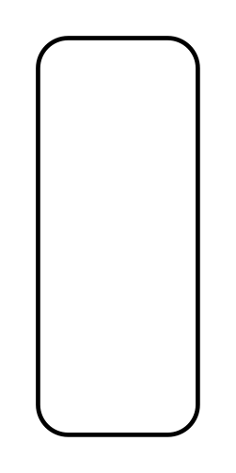
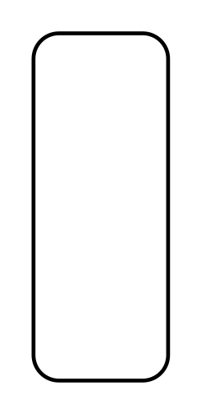




System Track Courses
Operating Systems
Architecture
Compilers
Distributed Systems
Computer Systems Engineering
Introduction to Computer Systems

Slide 12
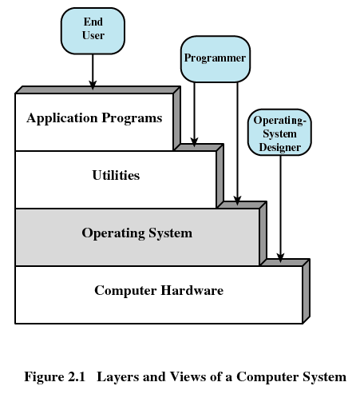
Layers（层次） of Computer Systems

Slide 13
Why Study Computer Systems?
Lots of systems companies
  Microsoft, Google, IBM, EMC, CISCO, VMware
  What’s Google’s core?
    Google Cluster, GFS, MapReduce, BigTable
  Good systems knowledge is a necessity to get you a good offers/promotions at such companies and top universities

Slide 14
Where are We?
Programming Lies at the Heart of Most Modern Systems
  Computer systems
  Embedded devices: cell phones, automobile controls, …
  Electronics: DSPs, programmable controllers
Programmers Have to Understand Their Machines and Their Limitations
  Correctness: computer arithmetic, storage allocation
  Efficiency: memory & CPU performance

Slide 15
Where are We?
From abstractions to details (realities)
From application level to system level
From java to C

Slide 16
Features of This Course
Enduring Concepts
From programmer’s perspective
Actively study
Becoming the rare “power programmer”

Slide 17
Enduring concepts
Computer systems consist hardware and systems software that work together to run programs
Specific implementations of systems change over time
But the underlying concepts do not
All computer systems have similar hardware and software components that perform similar functions

Slide 18
From Programmer’s Perspective
Rather than system designer’s perspective
  Few students would have the opportunity to build a computer system
  It’s wasteful to teach every computer scientist how to design a microprocessor
  Knowledge of how to build does not transfer to knowledge of how to use

Slide 19
From Programmer’s Perspective
It covers a topic only if it affected
  correctness, performance or utility of user-level C programs
Take a broader and more realistic view of the system
  What the computer hardware is
  How modern computer works

Slide 20
Actively Study
New concepts are followed by practical problems
Homework problems and labs are also real
Learning by doing
  Working concrete problems
  Writing and running programs on real systems
Practical, concrete, hands-on and exciting

Slide 21
Becoming the Rare “Power Programmer”
Enlightened by an understanding of
  the underlying computer system
  and its impact on your application programs
You know
  How things work and
  How to fix them when they break

Slide 22
Good luck!

Slide 23
Overview of Computer Systems

Slide 24
Outline
Layers of computer systems
Suggested reading
  Preface 7-8, 1.2, 1.4.1, 1.7(before 1.7.1), 1.7.3, 1.8, 1.9.1 (the first paragraph), 4 asides in chapter 1

Slide 25
Layers of Computer Systems

Slide 26
Computer Hardware - Von Neumann Architecture
Instructions / Program
Main
Memory
Arithmetic
Unit
Control
Unit
PC
AC
IR
SR
Addresses
Input/Output
Unit
E.g. Storage

Slide 27
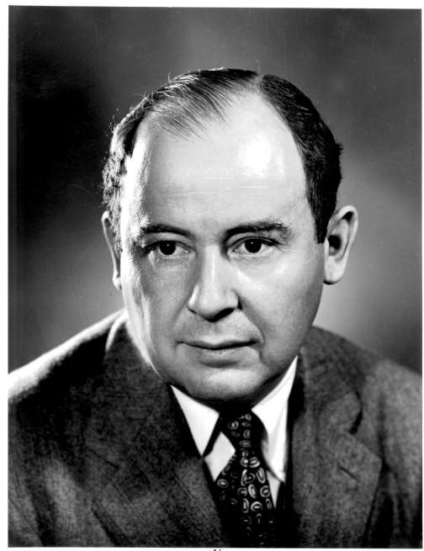
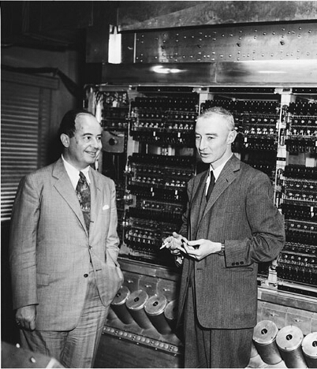
EDVAC

Slide 28
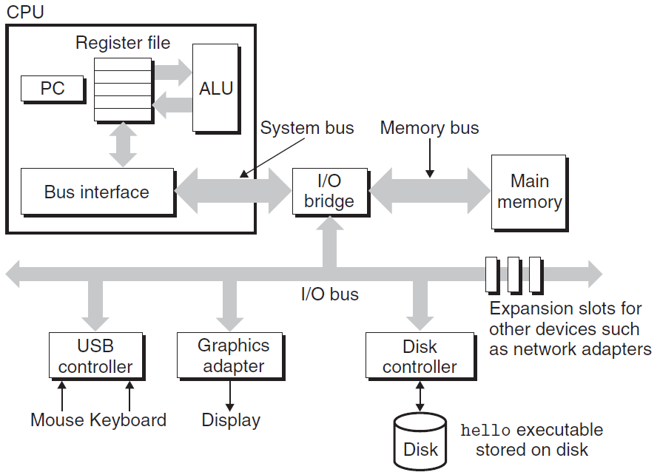
IA-32

Slide 29
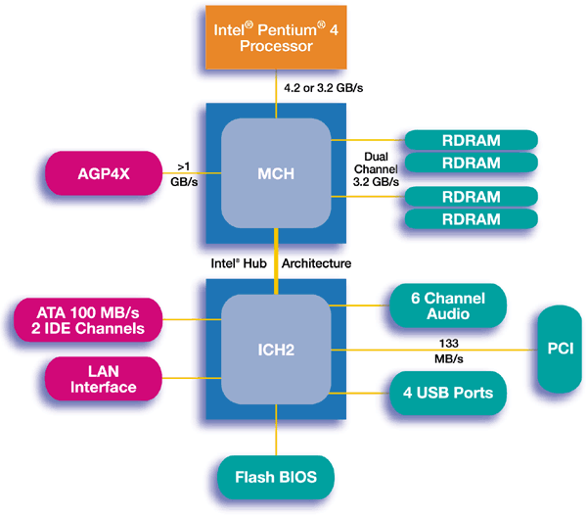
IA-32

Slide 30
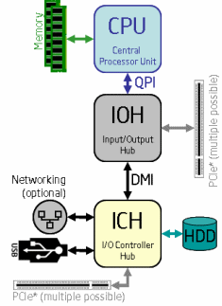
IA-32

Slide 31
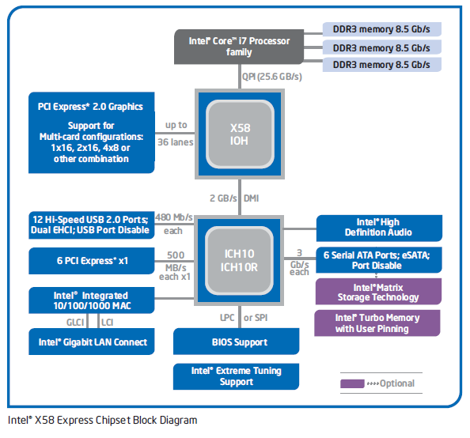
IA-32

Slide 32
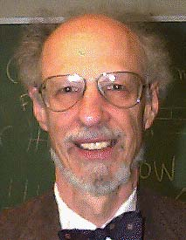
Operating Systems
1960’s
  IBM OS/360, Honeywell Multics,
Fernado Jose Corbató
  IEEE Computer Pioneer Award, 1982
  ACM Turing Award, 1990

Slide 33

Operating Systems
Unix
  Bell Lab, DEC PDP-7, 1969
  Ken Thompson, Dennis Ritchie, Doug Mcllroy, Joe Ossana
  1970 Brian Kernighan dubbed the system “Unix”
  Rewritten in C in 1973, announced in 1974
  BSD (UC, Berkeley), System V(Bell lab)
  Solaris (Sun Microsystem)
Posix standard
Ken Thompson, Dennis Ritchie
  ACM Turing Award, 1983

Slide 34
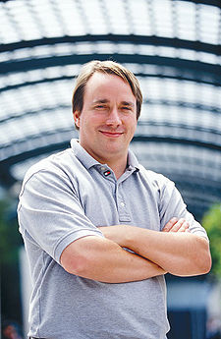

Linux
1991, Linus Torvalds
Unix-like operating systems
386(486)AT, bash(1.08), gcc(1.40)
Posix complaint version of Unix operating system
Available on a wide array of computers
  From handheld devices to mainframe computers
  wristwatch

Slide 35










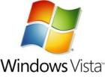
We have seen a bunch of Operating Systems

Slide 36












We have seen a bunch of Operating Systems

Slide 37
Utilities
Programming language
  ANSI C
Compiler
  GNU-gcc
Tools
  GNU tool chain

Slide 38
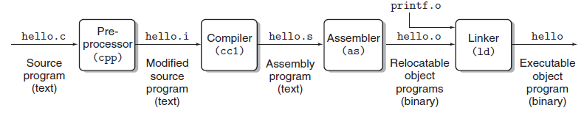
Compilation

Slide 39
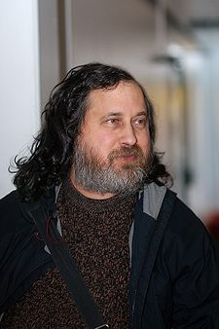

GNU
Free software
Richard Stallman, 1984
A complete Unix-like system with source code
An environment
  All major components of a Unix operating system
  Except for kernel

Slide 40
The C Programming Language
C was developed
  in 1969 to 1973
  by Dennis Ritchie of Bell Laboratories.
The American National Standards Institute (ANSI)
  ratified the ANSI C standard in 1989.
The standard defines
  the C language
  and a set of library functions known as the C standard library.

Slide 41
The C Programming Language
Kernighan and Ritchie describe ANSI C in their classic book
  which is known affectionately as “K&R” .
In Ritchie’s words, C is
  quirky,
  flawed,
  and an enormous success.
Why the success?

Slide 42
The C Programming Language
C was closely tied with the Unix operating system
  C was developed from the beginning as the system programming language for Unix.
  Most of the Unix kernel, and all of its supporting tools and libraries, were written in C.

Slide 43
The C Programming Language
C was closely tied with the Unix operating system
  As Unix became popular in universities in the late 1970s and early 1980s, many people were exposed to C and found that they liked it.
  Since Unix was written almost entirely in C, it could be easily ported to new machines, which created an even wider audience for both C and Unix.

Slide 44
The C Programming Language
C is a small, simple language.
  The design was controlled by a single person, rather than a committee, and the result was a clean, consistent design with little baggage.
  The K&R book describes the complete language and standard library, with numerous examples and exercises, in only 261 pages.
  The simplicity of C made it relatively easy to learn and to port to different computers.

Slide 45
The C Programming Language
C was designed for a practical purpose.
  C was designed to implement the Unix operating system.
  Later, other people found that they could write the programs they wanted, without the language getting in the way.

Slide 46
The C Programming Language
C is the language of choice for system-level programming
There is a huge installed base of application-level programs as well.

Slide 47
The C Programming Language
However, it is not perfect for all programmers and all situations
  C pointers are a common source of confusion and programming errors
  C also lacks explicit support for useful abstractions such as classes and objects
  Newer languages such as C++ and Java address these issues for application-level programs

Slide 48
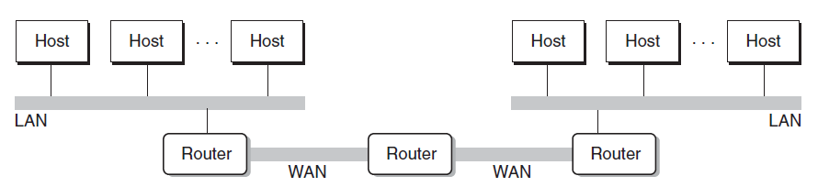
Networking
Computers are connected by networks

Slide 49


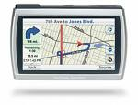
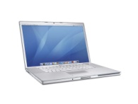
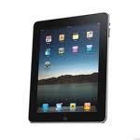
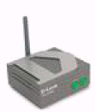

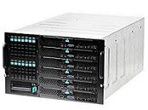

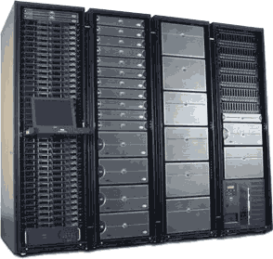
Cloud
Computer Systems support the cloud computing
Wireless
Ethernet

Slide 50
Platforms
Hardware platform
  Intel IA-32/x86-64
Operating system
  Linux
Programming language
  ANSI C
Utility
  GNU
Networking
  TCP/IP, Sockets

Slide 51
Important Themes
Concurrency an Parallelism
  Concurrency: multiple, simultaneous activities
  Parallelism: the use of concurrency to make a system run faster
abstraction

Slide 52
